Slide 1

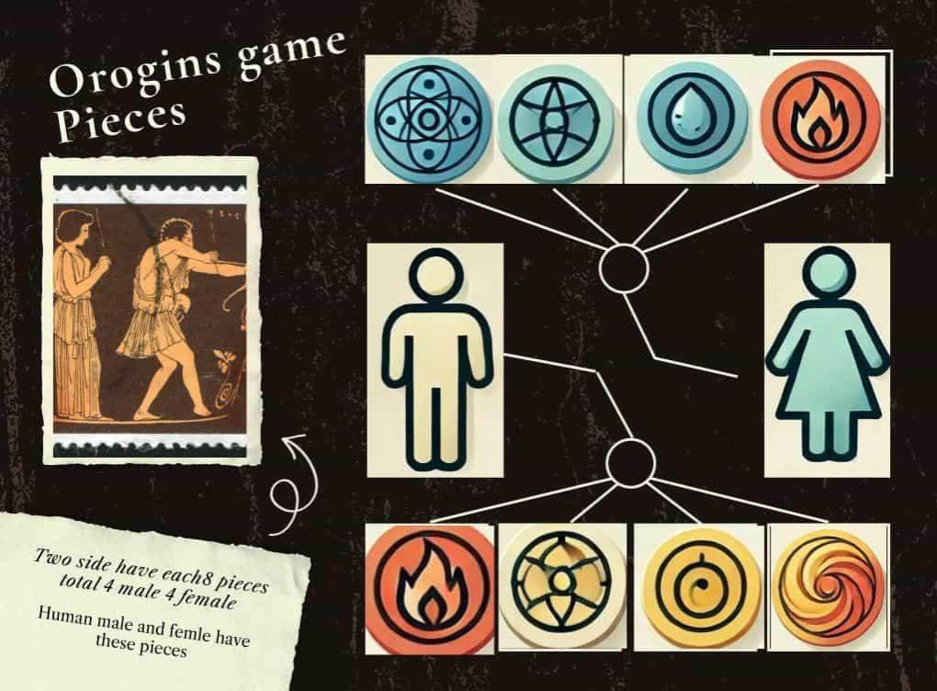

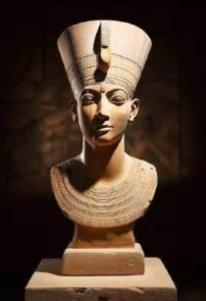




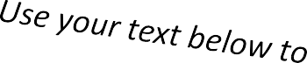
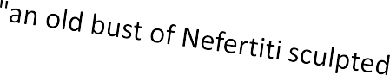
1 Hear
1 Hear
1 See
1 Taste
1 See
1 Smell
1 Smell
1 Touch
1 Touch

Slide 2



T itle
Title Slide
Project Title : Origins
Team Members : Samik, Syed and
INnostkihtuatizion/Department: University of Bradford
Date : 8/April/2025

Slide 3

Meet Our Team
Samik: Project Manager and Game Developer.
Ahmad: RL Engineer
Nokhaiz: Game Tester

Slide 4


Aims and Objectives
Business Case and StakeHolders Problem statement
Games Rules and Overview
Functional and Non-Functional Requirements
Domain Knowledge
Class for Game Development Class Diagram of RL
Live Demo Github/Unity/Vs Code.
SDLC and CRISP-DM
Agile
Quality Plan
Multidisciplinary Issues of AI in games
Risk Assessment Table
Smart Ethics Ai Toolkit Analysis
Constraints Limitations and Opportunities.
Conclusion

Slide 5


Aims Develop OrOrigins — a strategic two- player board game powered by Reinforcement Learning (PPO), where an AI learns through self-play and adapts to complex scenarios.
Objectives: Game Design & Logic: Design a 10x8 board, interactive game pieces, implement movement, capturing, and turn logic in Unity, and enforce game rules (elemental and piece interactions). Reinforcement Learning: Define state/action space, reward system, and train the AI agent via self-play using PPO for optimal strategy. Environment & AI Integration: Develop the game environment in Unity or Pygame, create a custom Gym environment, and integrate the trained RL agent for AI vs. Human gameplay. Testing, Evaluation & Deployment: Test AI performance, collect feedback, and deploy the game across multiple platforms (Windows, macOS, Android).

Slide 6

Business Case Origins is a strategic board game that integrates AI for challenging gameplay. The project aims to develop a single-player mode with potential for multiplayer, utilizing an RL agent to enhance gameplay. Cross-platform deployment and unique rules could attract a large audience.
Stakeholders 1.Development Team 2.Academic Supervisor 3.End User 4.Game Developers

Slide 7

Problem statement We have been assigned the game that we are required to create from the scratch utilizing the rules provided and ensure that game is capable of automation meaning that it can play against the human being without the need for two people.
Scope
This project aims to integrate a reinforcement learning (RL) agent into the OrOgins strategy game, automating gameplay. It involves using Pygame to design and train a Proximal Policy Optimization (PPO) model, and Unity for creating a visually enhanced 2D version of the game. .

Slide 8

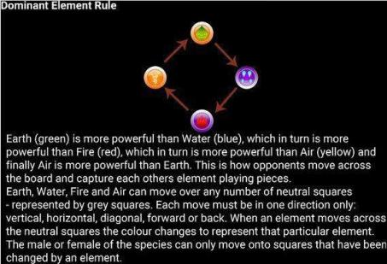
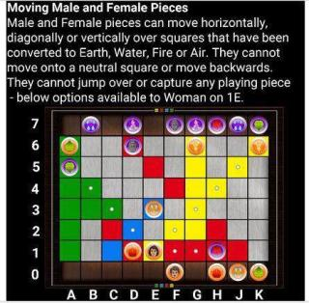
Game Rules and Overview

Slide 9

Domain Knowledge
Movement Rules Elemental
Rules Capture Mechanics.
Male/Female Pieces Winning Conditions
Data Availability
.Synthetic data generated via a custom
game environment based on state, action, and r

Slide 10

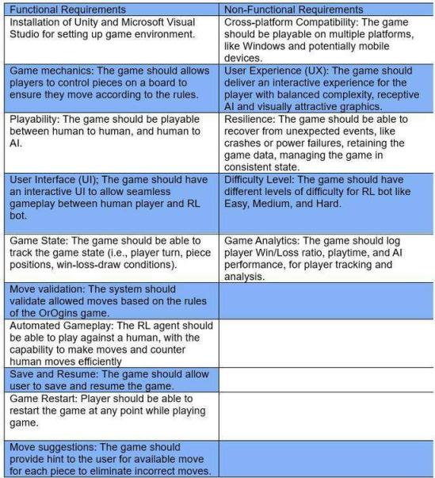
Functional and Non-Functional Requirements

Slide 11

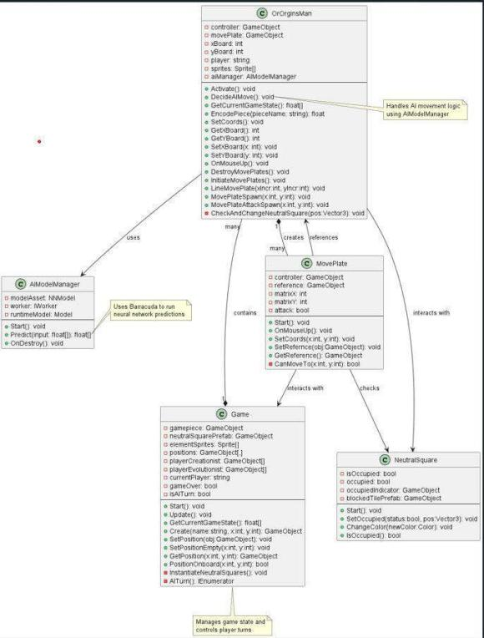
Class Diagram of Game

Slide 12

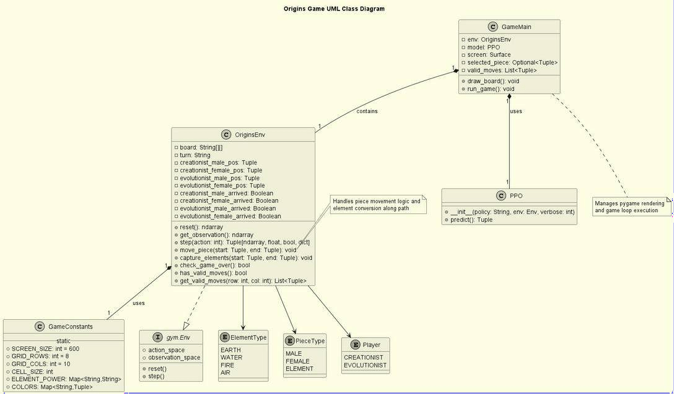
Class Diagram of RL

Slide 13
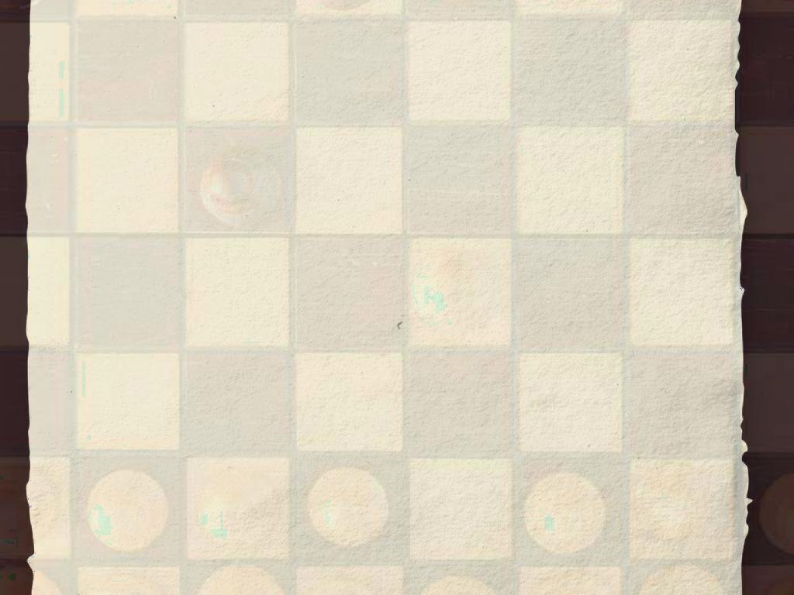
Live Demo

Slide 14
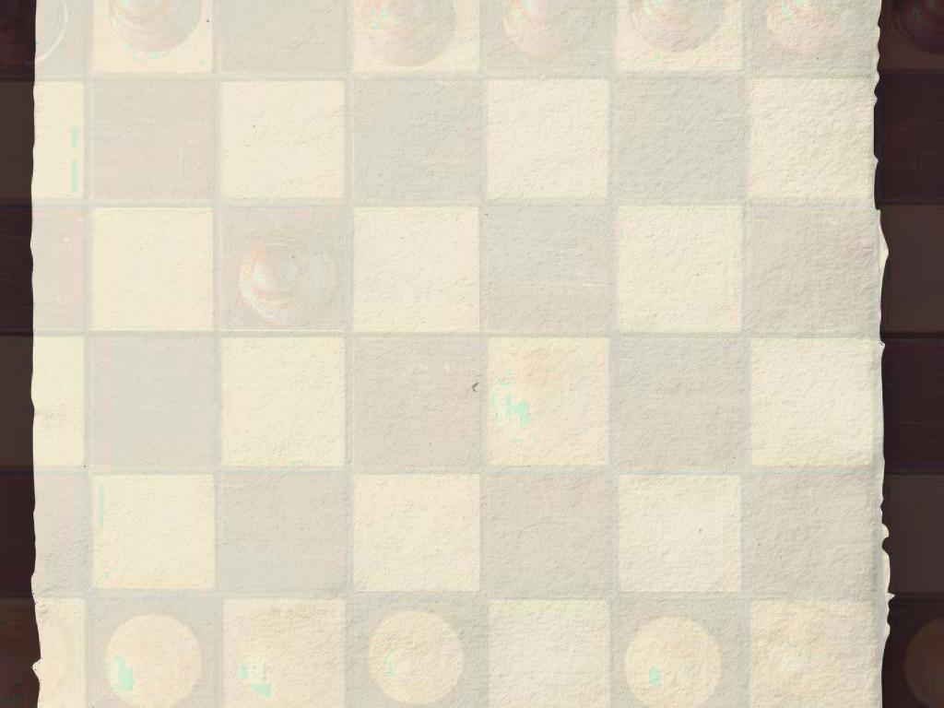
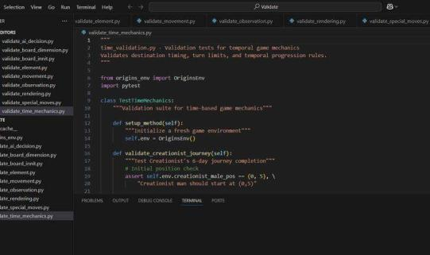
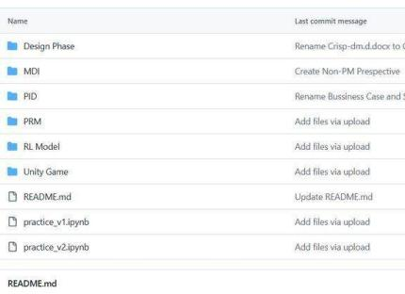
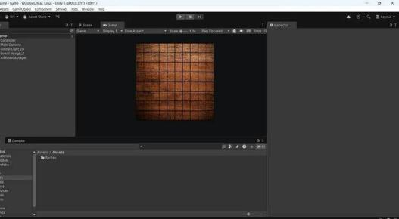
GitHub Unity/Vs Code.

Slide 15
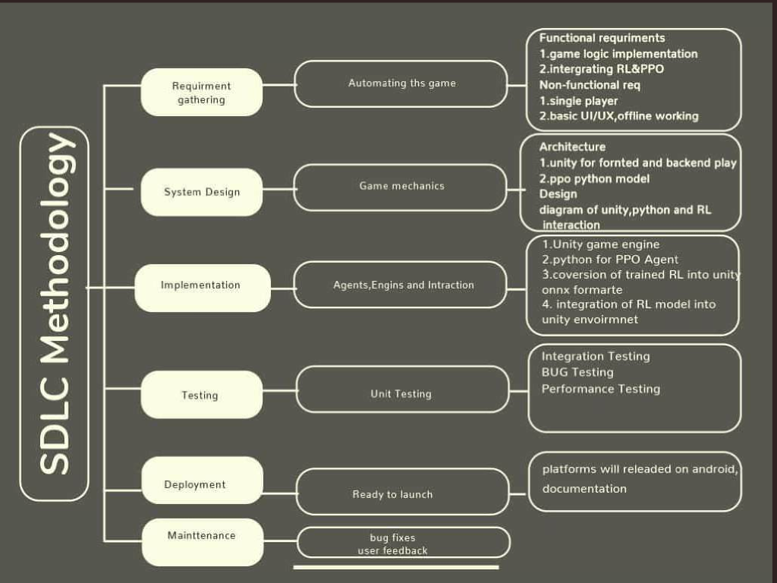

Slide 16
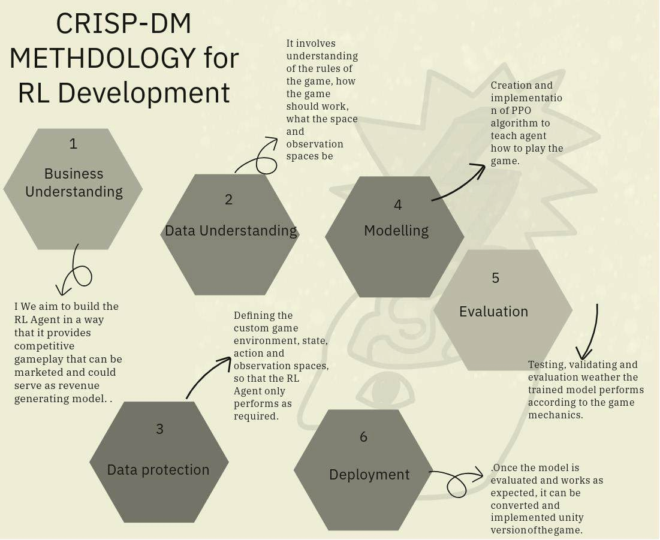

Slide 17

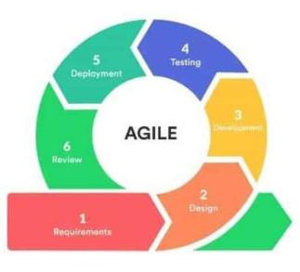
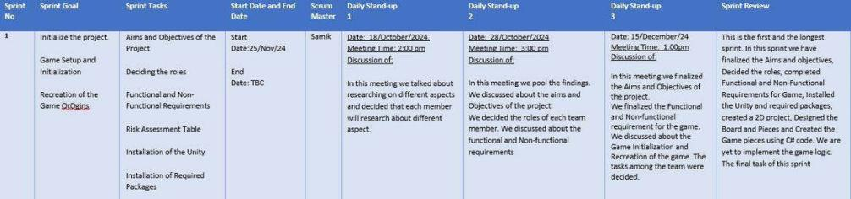
Agile

Slide 18
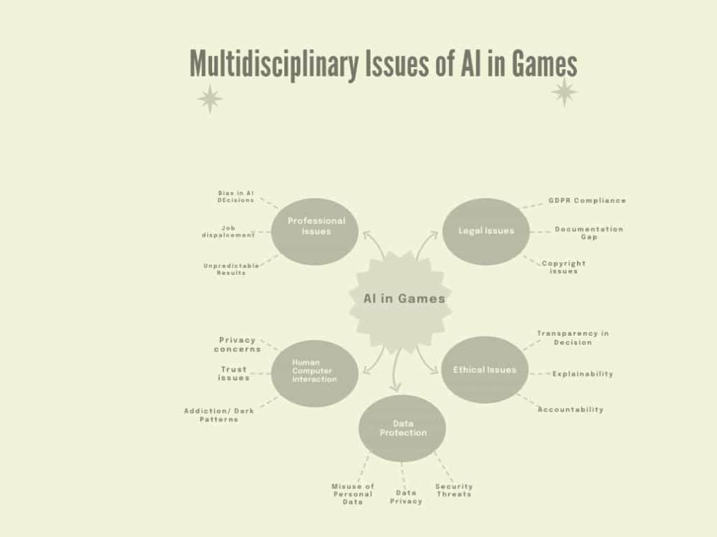

Slide 19

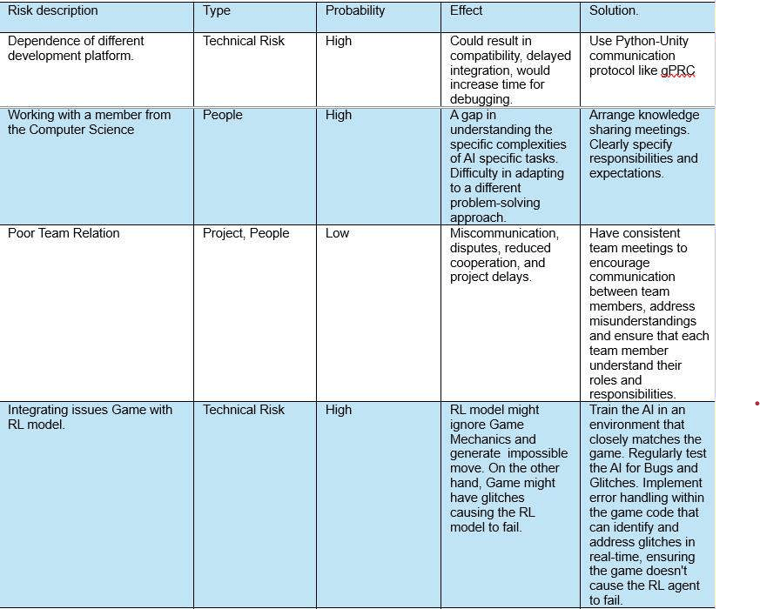
Risk Assessment Table

Slide 20

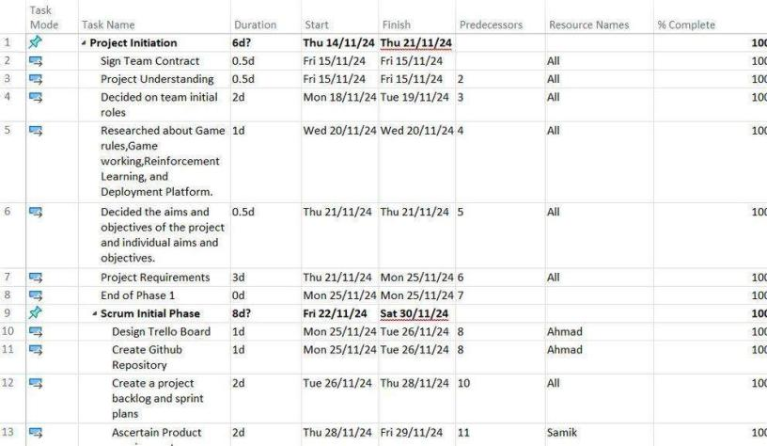
Project Plan

Slide 21



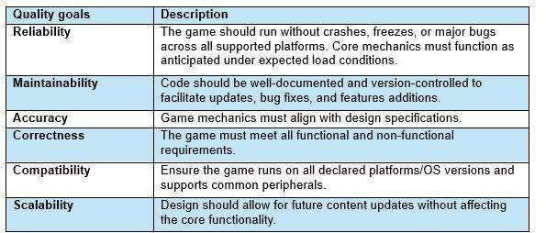






Quality Plan

Slide 22

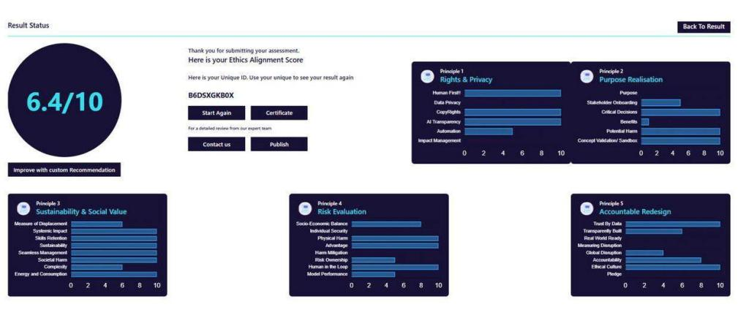
Smart Ethics AI Toolkit

Slide 23

.
Constraints and Limitations
Time Constraints No Multiplayer Support 2D Graphics Only Offline Deployment Only Opportunities/Growth Areas Updating the Theme and Skins of the Game Expansion on Different Platforms RL Model Improvements Increase Game Awareness
Challenges and Issues Technical Skill Gap
Between Team Members Lack of Motivation Among Team Members Implementation of Game Logic Testing the RL Model Working on Different Methodologies

Slide 24

Conclusion
Our project made significant progress despite its complexity. Core functionalities were implemented on Pygame, but additional time is needed to fully develop win/loss/draw conditions and complete logic integration within Unity.

Slide 25

References:
Adobe Express 2025 accessed from https://new.express.adobe.com/id/urn:aaid:sc:EU:420e4410-def8-5319-9 bd5- 93fdabae371e?category=text
Mungfail 2025 accessed from https://mungfali.com/explore/Agile-Methodology-
Diagram
Yanamala, A.K.Y. and Suryadevara, S., 2023. Advances in Data
Protection and Artificial Intelligence: Trends and Challenges.
International Journal of Advanced Engineering Technologies and Innovations, 1(01), pp.294-319.
Yanamala, A.K.Y., Suryadevara, S. and Kalli, V.D.R., 2024. Balancing innovation and privacy: The intersection of data protection and
artificial intelligence. International Journal of Machine Learning Research in Cybersecurity and Artificial Intelligence, 15(1), pp.1-43.
Mazurek, G. and Małagocka, K., 2019. Perception of privacy and data
protection in the context of the development of artificial intelligence. Journal
of Management Analytics, 6(4), pp.344-364.

